Slide 1
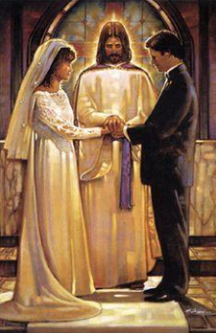
Key Vocabulary
Commitment | The state or quality of being dedicated to a cause or activity.
Compassion | Showing care to others, treating them with kindness and feeling a strong desire to help people in need.
Loyalty | Showing devotion and faithfulness to someone or something.
Fidelity | The state of being faithful and loyal.
Inspirational | A person o thing that motivates, uplifts or gives one the confidence to do something.
Mission | An important task or duty that a person is given to do.
Apostle | Someone sent on a mission.
Prophet | Someone who speaks on behalf of God or who is divinely inspired to reveal the will of God.
Life Choices Knowledge Organiser
Key Information
1 | I know that we all have a mission in life and I know what it means to be committed.
2 | I know about the work of Christian service.
3 | I know about the Sacrament of Marriage.
4 | I know the symbols of the promises and about the blessing of the rings.
5 | I know that the Beatitudes are found in Matthew 5:6-9.
6 | I know we are all called to live in love and service. We are called to show care and commitment.
Is Commitment Important?
Prior Knowledge
Year 1 | Baptism | Baptism is an invitation to belong to God’s family.
Year 2 | Signs and Symbols | Some signs and symbols of Baptism include Holy water, oil of chrism and a white garment.
Year 3 | Promises | Parents and godparents make special promises on behalf of their children and godchildren.​ ​ These promises include being a good Christian.
Year 4 | Called | God calls us to do special jobs and to act in certain ways. These are our callings.
Key Scripture Links
1 | Ephesians 4:1-7
2 | Ephesians 4:11-13, 15
3 | Proverbs 31:10-29
4 | Matthew 5:6-9

