Slide 1
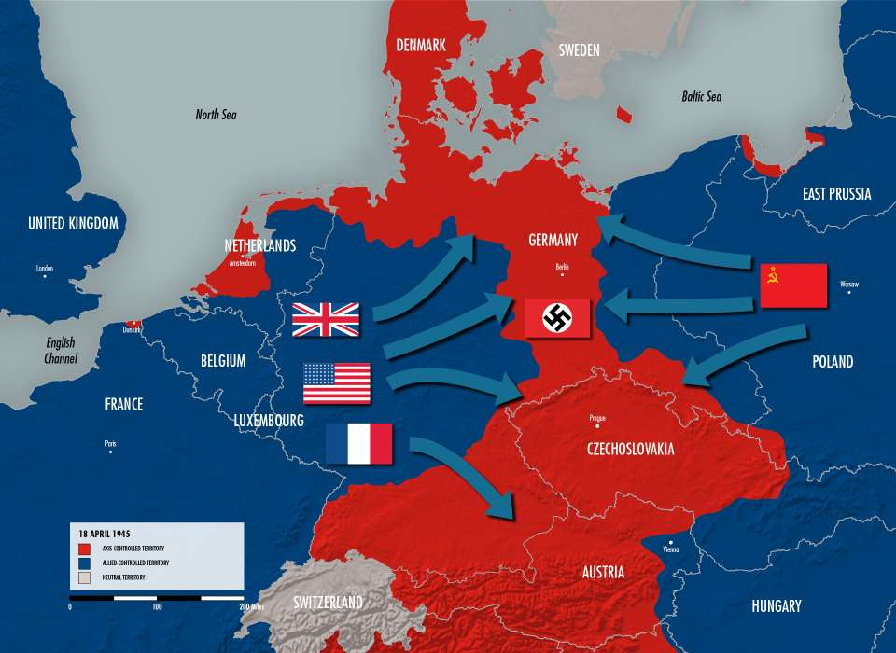
WW2 Knowledge Organiser
Key Vocabulary
Allied Powers | Countries including: Britain, France, the Soviet Union and the USA, that united to fight the Axis Power.
Axis Powers | Germany, Italy and Japan
Civilian | A person who was not the police or the armed forces.
Concentration camp | A place where large numbers of people, especially Jews, were held and killed.
Evacuee | A child or vulnerable adult who was
Invade | To enter or occupy a country by force.
Nazi | A follower of Adolf Hitler.
Persecute | To treat someone cruelly or unfairly.
Propaganda | Biased news, media and communication used to influence people’s opinions.
Rationing | The limited supply of food, clothes and other goods to prevent shortages.
Rhineland | An area of Western Germany that runs along the River Rhine.
Key Knowledge
1 | The Second World War lasted from 1939 to 1945 and was between the Allied Powers and the Axis Powers. After six years, the Allied Powers won.
2 | George VI was the reigning monarch during WW2. He is the Grandfather of King Charles III.
3 | During the War there were Allied forces which were Great Britain, France USA and China and the Axis forces which were Germany, Italy and Japan.
4 | Adolf Hitler was the leader of the Nazi party in Germany and they had strict and unfair policies.
5 | War broke out when Adolf Hitler invaded Poland in 1939 and the Axis forces vowed to support them.
6 | Britain was bombed alot by the Germans, especially during the Blitz (1940) and people had to build shelters in their gardens to protect themselves.
7 | All able bodied men were made to join the Army and go off to war to fight. This left families without workers earning money.
8 | Women took on the roles of men in factories and farms and contributed to the war effort.
9 | There were shortages of food due to the Germans stopping shipments into the country. Food was rationed which meant people only had a certain amounts of certain foods.
10 | Children were often evacuated to the countryside away from the bombing in the cities.
11 | The Holocaust is a significant part of WW2. This was the persecution of Jewish people by the Nazi party.
Prior Knowledge
1 | Y1 Bright Lights, Big City | London is an important capital city and was targeted during the war by the Germans.
2 | Y4 Traders and Raiders | The Vikings were invaders like Hitler and took land by force.
3 | Y4 I am Warrior | The Romans were invaders like Hitler and took land by force.
4 | Y4 Road Trip USA | People have not always been treated equally. Black people were persecuted for many years before the Civil Rights Movement just like Jewish people were persecuted by the Germans.
5 | Y5 Off with her Head | Battle of Bosworth was also a battle over terriority.
6 | Y6 Revolution | The British empire was also established through invasion.
Significant Individuals
Winston Churchill – British Prime minister Adolf Hitler – Leader of Germany Charles de Gaulle – President of France Benito Mussolini – Prime Minister of Italy Franklin D Roosevelt – President of the US

