Slide 1
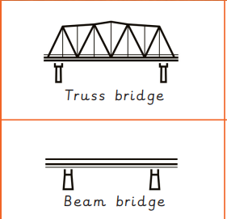
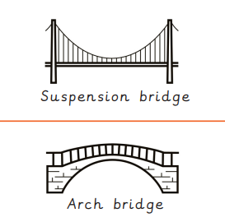
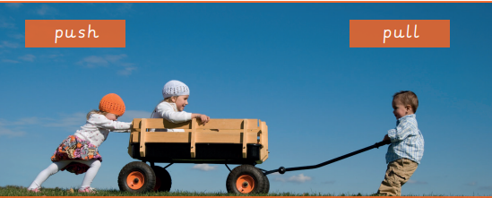
Key Vocabulary
Arch Bridge | A bridge which is built with a curved arch.
Beam Bridge | A bridge which is built with horizontal beams and vertical pillars.
Bench hook | A tool which hooks onto the edge of the workbench. It is used to hold woodwork still when sawing.
Compression | A squashing force caused when parts of a structure are pushed together.
Coping Saw | A saw with a narrow D-shaped metal blade used for cutting curves in wood.
Reinforce | To make a structure or material stronger, especially by adding another material or element to it.
Structure | Something which stands, usually on its own.
Suspension Bridge | A bridge which is supported by vertical cables and suspended by cables which run between pillars that are connected onto either end of the bridge.
Tension | A stretching force caused by two parts of a structure being pulled apart.
Truss Bridge | A bridge which is built from a series of triangular beams.
DT: Structure
Knowledge Organiser
Key Figures
Isambard Kingdom Brunel Thomas Telford
Key Knowledge
1 | Pulls ad pushes are both forces
2 | Gravity is a force which pulls everything towards the centre of the Earth. The weight of something is the force that the Earths gravity is having on it.
3 | Forces can change the shape of objects, they can also make objects being to move, speed up or slow down.
4 | Bridges provide a safe route over obstacles, including roads and rivers. They are used by pedestrians, cars, trains and pipelines.
5 | The four main bridge types are the beam bridge, arch bridge, truss bridge and suspension bridge. They each spread forces in different ways to remain strong and stable.
Prior Knowledge
1 | A structure is something which has been formed or made from parts.
2 | A strong structure is one that cannot be broken easily.
3 | The strength and stiffness of a structure is key to keeping it standing.
4 | Objects with a wide or flat base are more stable.
5 | A free-standing structure is something that can stand on its own.

