Slide 1
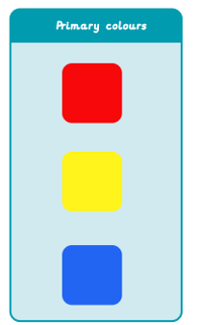
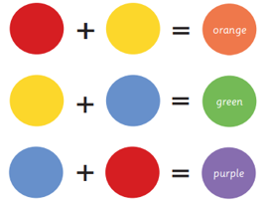
Art – Painting
Knowledge Organiser
Key Vocabulary
hue | Describing an exact colour: sky blue, dark green, rose pink.
mix | Combining two or more colours together.
pattern | A design in which shapes, colours or lines are repeated.
print | Transferring an image onto another surface, for example, finger paiting.
shade | How light or dark a colour is.
primary colours | Red, blue and yellow
Secondary colours | Orange, green and purple made by mixing two primary colours together.
Key Knowledge
1 | Primary colours can be mixed together to make secondary colours.
2 | Brush size helps to paint different shapes and patterns more accurately.
3 | Painting simple things, such as numbers, helps to focus more on colour than what is being painted. (Jasper Johns)
4 | Different objects can be used to print when painting, such as lego bricks.
5 | Different shades of colours can be made when mixing colours together. Add more of the lighter colour to get a lighter shade or add more of the darker colour for a darker shade.
6 | Artists use painting skills for other art forms, not just for painting on a canvas. (Clarice Cliff-tree plate)
Key Artists
Jasper Johns- was a painter and print maker. Clarice Cliff- famous for colour rich designs. She was a ceramic artist.
Prior Knowledge
1 | F1 | Mark making using different tools.
2 | F2 | Painting and printing, using different colours and objects, eg, sponges.

