Slide 1
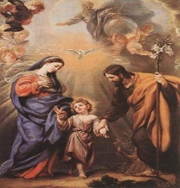
Key Vocabulary
Family | A group of one or more parents and their children, living together as a unit.
Love | An intense feeling of deep affection.
Care | Doing what you need to, to look after something or someone.
Psalm | A sacred song or hymn.
God’s children | We are part of God’s family- he cares and loves us all.
Families Knowledge Organiser
Key Information
1 | The people who you live with are who makes us you family. There may also be other people who are part of your wider family.
2 | Your family love and care for you by supporting you in lots of different ways. For example, washing your clothes, making you food and making sure you go to school.
3 | Psalms tell us information about different things, such as how God loves and cares for us.
4 | Psalms are taken from the Bible and the Bible tells us about God’s love.
5 | Jesus grew up in a family who loved and cared for him.
6 | I know I am part of the family of God.
How do families show love and care?
Key Scripture Links
1 | Psalm 63: 6-9
2 | Psalm 16: 7-9
3 | Psalm 28: 6-8
4 | Luke 12: 27-30
Prior Knowledge
F1
F2

