Slide 1
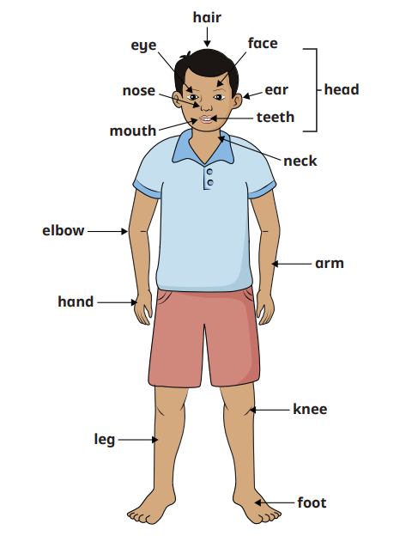
Human’s Knowledge Organiser
Key Vocabulary
human | A mammal that is a person
body | A person’s physical structure, including bones, flesh and organs
body parts | An organ, eye or tissue of a human being
senses | An ability to understand, recognise and react to something
touch | Our skin helps us to feel things.
sight | What we see, our eyes help us to see.
sound | What we can hear, our ears help us to hear.
taste | Our mouth and tongue help us to taste.
smell | Our noses help us to smell things.
Key Information
1 | The human body has lots of different body parts.
2 | Eyes are what help us to see but we also need enough light.
3 | Our ears are what help us to hear different sounds.
4 | We use our mouths and tongues to help us to taste.
5 | Skin is the part of the body that helps us feel touch.
6 | Our nose is what we use to smell different objects. There are pleasant and unpleasant smells.
Prior Knowledge
F1 | Knows how to use all their senses in hands-on exploration of natural materials.
F2 | Knows how to describe what they see, hear and feel whilst outside.

