Slide 1
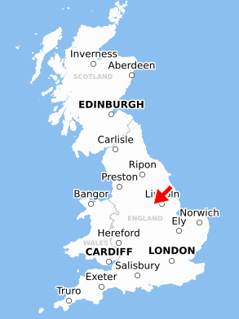
How Green is Our School Knowledge Organiser
Key Vocabulary
village | A group of houses and buildings smaller than a town
town | A built-up area with a name and defined boundaries
city | A large town
county | A large area of the UK
compass | Equipment to tell you a direction of where to go
human features | Things that have been made or built by humans
physical features | The natural features on the Earth’s surface
recycling | Waste material set aside to be recycled
pollution | Harmful materials in the environment
Key Information
1 | School, church, houses and shops are human features in their local area.
2 | Ollerton is in an area of Mansfield, which is in Nottinghamshire. Nottinghamshire is a county in England. Nottingham is the local city.
3 | The River Trent is in Nottinghamshire and the River Maun is local to school in Ollerton.
4 | School, church and children’s homes are in the same locality and can be seen on a map of Ollerton.
5 | Places are polluted by the people who live in them, especillay in cities due to littering and driving.
6 | Littering and pollution has an affect on wildlife and can damage animals hobitats.
7 | Humans in the locality can live in a ‘green way’ by walking some journeys instead of driving, cutting down on using electricity and recycling different objects.
Ollerton
Prior Knowledge
F1- Lent Term | Children know there are different places in the world and have seen photographs.
F2 Autumn Term | To play with small-world models. To notice objects and features in their own environment.
F2 Pentecost | Children know aspects of a familiar world, such as where they live.

