Slide 1
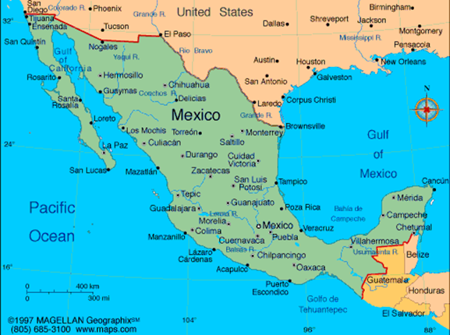
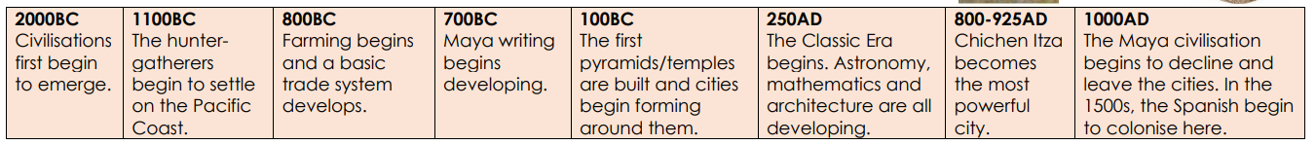
Hola Mexico Knowledge Organiser
Key Vocabulary
Civilisation | A well-organised and developed society.
Climate | The weather in a particular place over a period of time.
Culture | The lifestyle of a group of people or a society.
Diverse | Very varied or different.
Equinox | A time when the length of the day and night are the same.
Heritage | Traditions, languages or buildings from the past that are important to a particular society.
Indigenous | People, plants or animals that originated in a place.
Landscape | A large area of land.
Heritage | Traditions, languages or buildings from the past that are important to a particular society.
Region | A geographical area with its own unique features and characteristics.
Tradition | An activity, custom or belief that people have continued to follow for a long time.
Key Information
1 | The Mayans existed between 2000BC to 1600AD in an area called Mesoamerica which is now Mexico and parts of America.
2 | Mayan people lived in a hierarchical society ruled by Kings and Priests at the top and Slaves and Farmers at the bottom
3 | Religion was very important to the Ancient Maya, they built impressive temples to show this. The Ancient Maya worshipped their kings like they were gods but they also worshipped their ancestors and a range of different gods and goddesses.
4 | The Maya lived in many city states and each city state had its own ruler.
5 | Ordinary Maya citizens lived in one room houses built from mud and timber.
6 | Men were responsible for providing for their families, women would prepare food and clothes and the children would learn these skills from their parents.
7 | Maya people would eat meat as well as their own grown crops, but maize was their staple food. The cacao bean was used to make a drink for the ruling classes.
8 | The Maya were an advanced civilisation who communicated using their own language (Mayan), had a written form of communication (glyphs).
9 | They also developed one of the most advanced complex numerical systems of their time and invented their own calendar, among many other things.
10 | They were conquered by the Spanish around 1600AD
Prior Knowledge
1 | Y3 Tribal Tales | Mayan people lived in city states like the tribes of the Stone Age, Iron Age and Bronze Age
2 | Y3 Gods and Mortals | The Mayans were an Ancient civilisation like the Greeks. They worshipped different Gods and Goddesses like the Greeks.
3 | Y4 I am Warrior | The Mayans were warriors like the Romans and Warriors were important people in society.
4 | Y5 Pharaohs | The Ancient Egyptians were also an Ancient Civilisation ruled by a hierarchy.
5 | Y5 Pharaohs | The Mayans and Egyptians worshipped different Gods for different reasons.
6 | Y5 Pharaohs | The Mayans developed a pictorial writing system like Egyptian glyphs.

