Slide 1
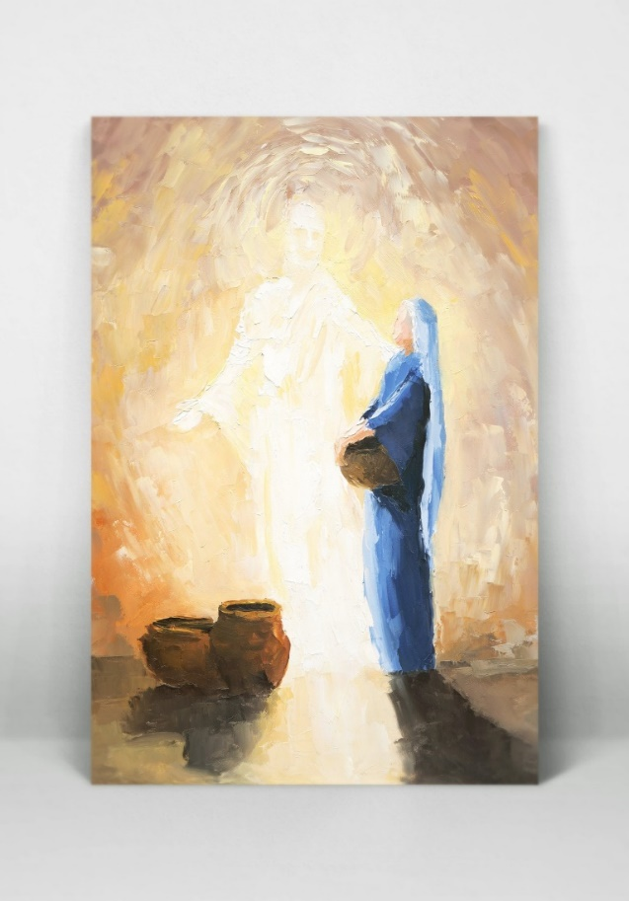
Key Vocabulary
Advent | A season in the Church year where Christians prepare for the celebration of the birth of Jesus.
Angelus | A Roman Catholic devotion that commemorates the incarnation of Jesus said at noon and sunset.
Annunciation | The announcement by the Angel Gabriel to Mary that she would have a child.
Certainty | Something that is reliably true.
Christmastide | The time from Christmas until January 5th
Emmanuel | The name given to Christ as being the person who will deliver the kingdom.
Expectation | A strong belief that something will happen and you wait for this.
Incarnation | God became flesh in the human form of Jesus, the son of Mary.
Expectations Knowledge Organiser
Key Information
1 | Advent is the time of waiting for the prophecy of Isaiah to come true and that the Messiah will be born.
2 | The Annunciation is significant because this is the moment that Mary knew that she would become the Mother of Gods only son.
3 | The Angelus prayer is a devotion to Mary to recognise the importance of her mission.
4 | God came to Earth in the human form of Jesus and this is known as the Incarnation. Mary brought to life the human form of God.
5 | John the Baptist and the disciples had many expectations of Jesus as the Son of God.
6 | Christian belief is that we are expecting the second coming of Jesus and that Christ will come again.
Should we have expectations in life?
Prior Knowledge
1 | Waiting | Advent is a time of waiting. We wait in the same way that Mary waited for Jesus to be born.
2 | Preparations | Mary and Joseph had to prepare for the birth of the baby Jesus. Jesus came to us as God’s gift because He loves us.
3 | Visitors | The shepherds were some of the people that visited Jesus.
4 | Gifts | Jesus was a gift from God for all of humanity. During Advent we celebrate the gift of love and promise that is Jesus Christ.
5 | Hope | Advent is the Church’s season of waiting in joyful hope for the coming of Jesus, the Promised One, at Christmas and at the end of time
Key Scripture Links
1 | John 1:14-18
2 | Mark 1:1-5
3 | Isaiah 35:1-6, 9, 10
4 | Isaiah 62: 11-12
5 | 1 Corinthians 1: 8-9
6 | 1 Corinthians 16:22, 16: 13-14

