Slide 1
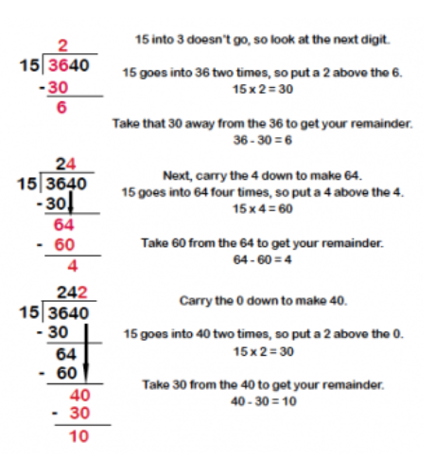
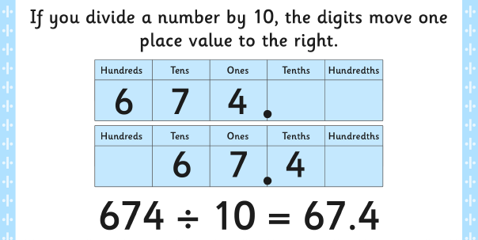
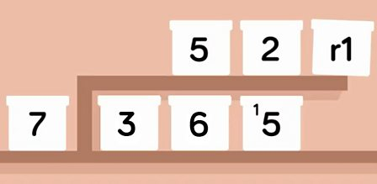
Four Operations: Division Knowledge Organiser
Key Vocabulary
Divide | Separate into parts.
Divisible | Capable of being divided.
Long division | Dividing large numbers into smaller parts.
Short division | A formal method of dividing numbers.
share | Separate into parts.
Equal | =
inverse | To use the opposite operation to check answers. For division this would be multiply.
Remainders | What is left over and cannot be divided equally.
Key Information
1 | When multiplying a number by a 2 digit number you must separate out the 2 digits.
2 | Using brackets, you must multiply by the ones to begin.
3 | Using brackets you then multiply the number by the tens.
4 | When multiplying the tens, you must remember to add in the place holder.
Worked Examples
Prior Knowledge
Y2 | That multiplication of 2 numbers can be done in any order (commutative).
Y3 | A multiplication table layout can be used to multiply 2 numbers together.
Y4 | A formal method layout can be used to multiply 2 and 3 digit numbers by 1 digit numbers.
Y5 | Long multiplication means that you partition numbers to ensure they are easier to multiply.
Worked Examples

