Slide 1
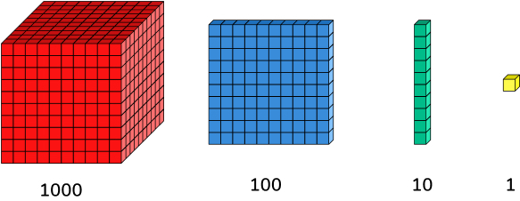

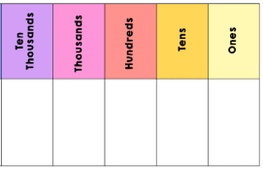
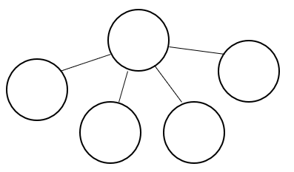
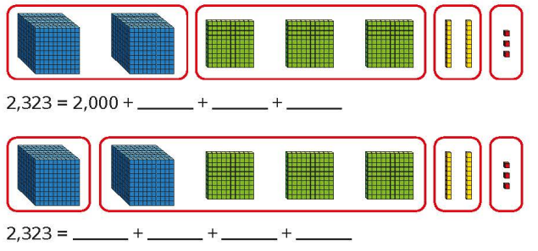
Number and Place Value: Flexible Partitioning.
Key Vocabulary
Base 10
Counters
Place value chart
Flexible partitioning | Partitioning a number into its parts in more than one way.
Ten thousands | 64,126
Thousands | 64,126
Hundreds | 64,126
Tens | 64,126
Ones | 64,126
Key Information
1 | Numbers can be split into lots of different parts and in different ways.
Prior Knowledge
Year 2 | Number: Place value | Numbers up to 100 can be partitioned flexibly, in different ways.
Year 3 | Number: Place value | Numbers up to 1000 can be partitioned flexibly, in different ways.
Worked Examples
Use the part whole models to partition 5721 in two different ways: Complete the number sentences for the Base 10 representations.
5721
5721
5000
1
4000
11
700
20
1700
10
300
20
3
1000
1300
20
3

Slide 2
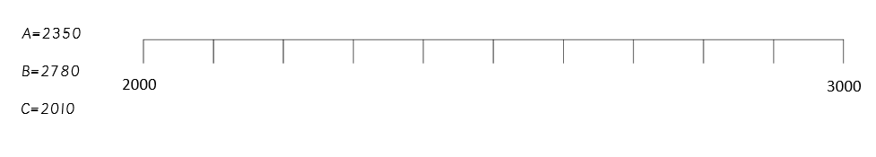

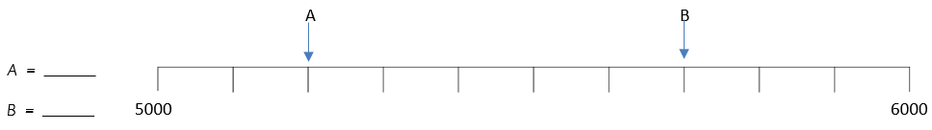
Number and Place Value: Number Lines to 10,000.
Key Vocabulary
Compare | To look for similarities and differences between two numbers.
Estimate | To roughly calculate and make a ‘good guess.’
Interval | All the numbers between two given numbers.
Number line | A horizontal line showing numbers spaced equally apart.
Order | Putting numbers in the correct sequence.
Key Information
1 | Number lines may go in ascending (upwards) or descending (downwards) order.
1 | The interval between each number is the same each time.
1 | The interval on a number line can be any number – it is not always 1.
Prior Knowledge
Year 2 | Number: Place value | Counting 1s and 10s on a number line, up to 100.
Year 2 | Number: Place value | Estimating numbers on a number line, up to 100.
Year 3 | Number: Place value | Ordering and comparing numbers on a number line, up to 1,000.
Worked Examples
Label these numbers on the number line: What number is each letter pointing to?
C
A
B
5200
5700

Slide 3
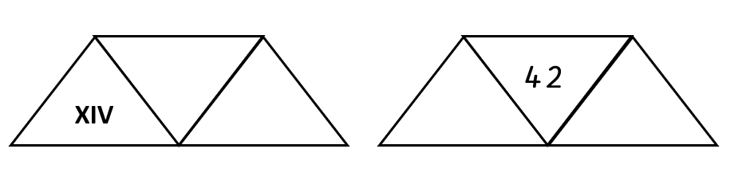
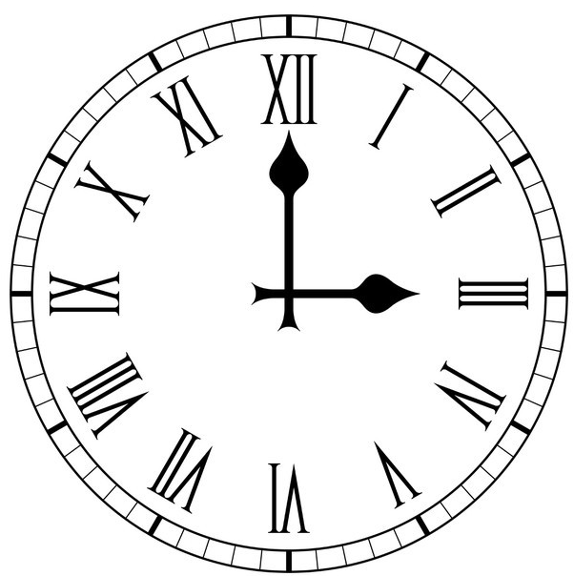
Number and Place Value: Roman Numerals.
Key Vocabulary
I | 1 one
II | 2 two
III | 3 three
IV | 4 four
V | 5 five
VI | 6 six
VII | 7 seven
VIII | 8 eight
IX | 9 nine
X | 10 ten
L | 50 fifty
C | 100 one hundred
Key Information
1 | If a smaller symbol appears after a larger symbol, you add them together. E.g. VI = V + I = 5 + 1 = 6.
2 | If a smaller symbol appears before a larger symbol, you subtract the,. E.g. IX = X – 1 = 10 – 1 = 9.
Worked Examples
Show each number in Roman numerals, digits and words: Solve the calculations: XV + X 15 + 10 = 25 XV + X = XXV 2) XXIII + V 23 + 5 = 28 XXIII + V = XXVIII 3) X + IV 10 + 4 = 14 X + IV = XIV
14
Fourteen
XLII
Forty-two
Prior Knowledge
Year 2 | Number:Place Value | Roman numerals to 12 on a clock face.
Worked Examples
Convert into digits: XX = 20 LX = 60 XVI = 16 Convert into Roman numerals: 84 = LXXXIV 92 = XCII 33 = XXXIII

Slide 4
Number and Place Value: Rounding.
Key Vocabulary
Multiples | Numbers in a times table. For example, multiples of 3 include: 3 6 9 12 and so on…
Place holder | A 0 which is worth nothing on its own, but changes the value of other digits.
Rounding | Making a number simpler, but keeping it close to what it was.
Key Information
1 | To round to the nearest ten, look at the ones digit.
2 | To round to the nearest hundred, look at the tens digit.
3 | To round to the nearest thousand, look at the hundreds digit.
4 | If the digit is 0, 1, 2, 3 or 4, round to the current ten/hundred/thousand.
5 | If the digit is 5, 6, 7, 8 or 9, round to the next ten/hundred/thousand.
6 | Replace digits after the column that you have rounded with a placeholder. Keep all previous digits the same.
Worked Examples
Round 8593 to the nearest thousand: The nearest thousands to 8593 are 8000 and 9000. 8593 2. To round to the nearest thousand, look at the hundreds digit. 8593 2. The digit is a 5. This means the number must be rounded to the next thousand. 3. The next thousand after 8593 is 9000. 9593 4. All digits after the one that was rounded must become a placeholder. 9000 Round 8593 to the nearest thousand: 9000
8000
9000
Prior Knowledge
Year 4 | Place value: Number lines | Number lines show where numbers are placed in relation to other numbers.
Worked Examples
8592 rounded to the nearest 10 → 8590 8592 rounded to the nearest 100 → 8600 8592 rounded to the nearest 1000 → 9000

