Slide 1
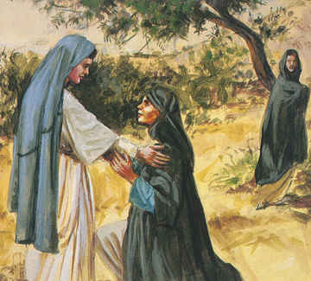
Key Vocabulary
Abraham | The man who God communicated with and had many descendants.
Boaz | The husband of Ruth.
Faith | Having complete trust in something or someone.
Family tree | A diagram showing the relationships between people in a family.
Holy Trinity | The three persons of God the Father, God the Son and God the Holy Spirit.
Jesus | The Son.
Naomi | An elderly woman in the Bible who needed to be cared for.
Proverb | A short saying or statement, giving advice.
Ruth | A woman in the Bible who stayed with Naomi to care for her.
Sarah | The wife of Abraham.
Solomon | A king of Israel who was known for his wisdom.
Wisdom | Experience, knowledge and good judgement.
People Knowledge Organiser
Key Information
1 | Jesus had a human family, just like we have our own families. These can all look very different.
2 | Abraham was one of the first people to listen to and follow God. He had strong faith. He was part of the human family of Jesus.
3 | Ruth stayed with Naomi to look after her. They created a loving family.
4 | Boaz helped Ruth look after Naomi and eventually, married Ruth.
5 | Solomon was a wise king who gave good advice and had lots of knowledge.
Where do you come from?
Prior Knowledge
1 | Families | God loves and cares for us all and all our families. Jesus was born into a human family.
2 | Beginnings | God was there at my beginning and the beginning of everyone and their family.
3 | Homes | God has a plan for everyone's family and we trust in this plan.
3 | Reconciliation | We reconcile our sins before God so that we are free of the weight of sin before receiving Gods blessing.
Key Scripture Links
1 | Genesis 15:1-5
2 | The Book of Ruth
3 | The Book of Proverbs

