Slide 1
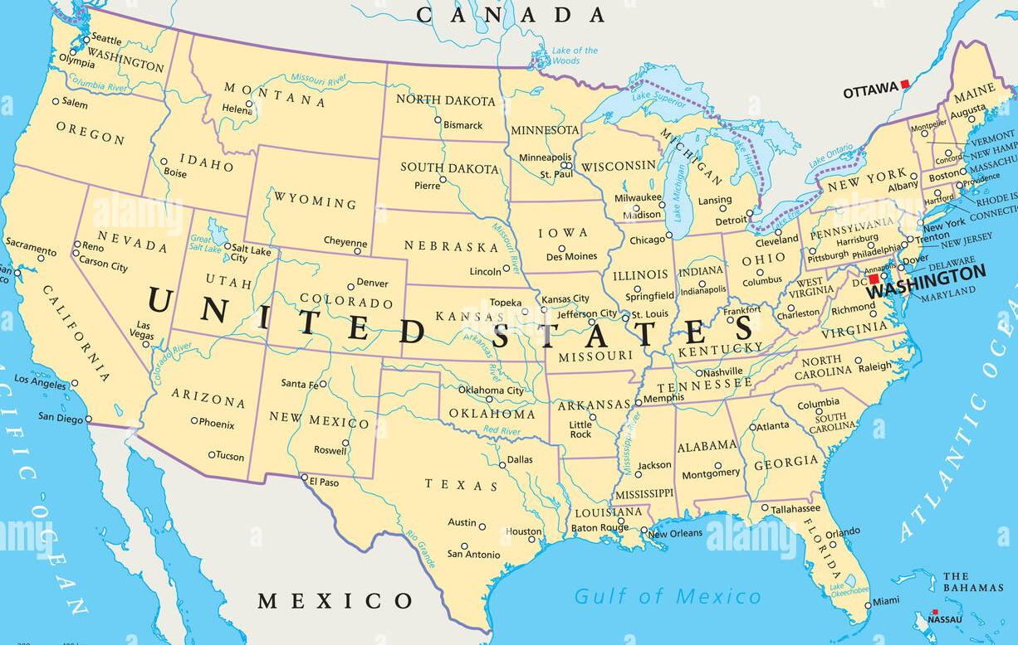
Road Trip USA Knowledge Organiser
Key Vocabulary
Colony | A country or area which is controlled by another country.
Landmarks | An object or feature which is easily seen and often well-known or famous.
Latitude | Lines on a map which show how far North or South somewhere is.
Longitude | Lines on a map which show how far East or West somewhere is.
Migration | Movement from one place to another.
Native Americans | The people living in North and South America before Europeans arrived.
Six-figure grid reference | Numbers which are used to pin-point locations on a map.
States | The sections that the United States of America are split into. There are 50.
Trade | Buying and selling items and services.
Tropic of Cancer and Capricorn | The two areas above and below the equator which are closest to the equator.
Key Information
1 | The United States of America is a country in the continent of North America.
2 | The North American climate is varied because it is large. Mexico and USA are hotter and Canada and Greenland are colder.
3 | There are 23 countries in North America. Some examples include USA, Cuba, Honduras and Dominican Republic.
4 | There are 50 states in USA and some of them have different laws.
5 | Six-figure grid references are more accurate than four-figure grid references. They can be used to locate places on maps.
6 | Some famous landmarks in USA include The Grand Canyon, The Statue of Liberty, The Golden Gate Bridge and Mount Rushmore.
7 | The UK exports machinery, vehicles and medicines to the USA. The USA exports fuel, oil, precious stones and aircraft to the UK.
8 | Most products are traded by air or by sea.
9 | Christopher Columbus was credited with discovering North America, where Native Americans were already living.
10 | Lots of Europeans moved to North America for land and opportunity. They created Jamestown – the first English colony.
Prior Knowledge
1 | Year 1 Bright Lights, Big City | Some famous landmarks in London include the London Eye and the Tower of London.
2 | Year 2 Safari Street Detectives | Climate is a typical weather pattern and this differs between Africa and the UK.
3 | Year 2 Safari Street Detectives | Kenya is very hot because the equator runs through it.
4 | Year 3 Ancient Greece | The climate in Greece is Mediterranean. The climate in UK is temperate.
5 | Year 3 Flow | The UK is split into counties.

