Slide 1
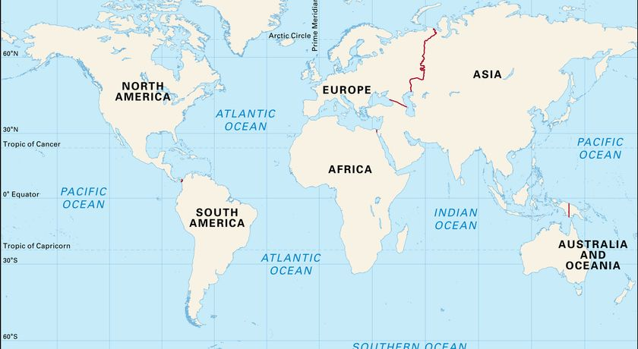
Blue Abyss Knowledge Organiser
Key Vocabulary
Adaptations | Characteristics of a living thing which help it to survive in its environment.
Climate change | Permanent changes to weather patterns.
Depth | How deep something (such as an ocean) is.
Fossil fuels | Energy such as coal, oil or natural gas that are formed from the remains of dead organisms.
Global warming | The process of the Earth warming up.
Great Barrier Reef | A gigantic coral reef, located off the coast of Australia.
Greenhouse gases | Gases which trap heat in the Earth’s atmosphere, causing global warming.
Natural resources | Materials or substances that can be found in nature.
Pressure | The force put upon something e.g. a human.
Zones of the sea | The different layers of the sea (sunlight, twilight, midnight, abyss, trenches).
Key Information
1 | The five oceans are: Pacific, Atlantic, Indian, Southern, Arctic. The three seas around the UK are: English Channel, North Sea and Irish Sea.
2 | The five zones of the ocean are: Sunlight zone 2. Twilight zone 3. Midnight zone 4. Abyss 5. Trenches.
3 | Animals are adapted to live in the sea. For example, some can glow in the dark to attract prey (bioluminescence), some have hinged jaws to eat large prey, some living in the dark have an excellent sense of smell.
4 | The Great Barrier Reef is located off the coast of Australia. It is a gigantic collection of coral and wildlife.
5 | Humans can impact the Great Barrier Reef negatively. They might damage it or pollute the sea, for example.
6 | Climate change can lead to global warming. Global warming makes the seas warmer and therefore, affects how well animals and plants can survive.
7 | Humans create energy from burning fossil fuels. This releases greenhouse gases which trap heat and make the Earth warmer.
8 | Climate change can affect natural resources such as water, leading to flooding (too much water!) or droughts (not enough water!)
9 | Humans can have a positive effect on natural resources by ensuring that they do not waste water and that they dispose of waste properly.
10 | Charities such as CAFOD and Water Aid work to make sure that water is shared fairly and used responsibly.
Prior Knowledge
1 | Year 1 Coastlines | A coastline is where land meets water.
2 | Year 1 How Green is Our School? | Humans impact the environment through their actions.
3 | Year 2 Sail the Seven Seas | Seas are smaller than oceans. Seas are usually located at coastlines.
4 | Year 2 Poles Apart | Animals adapt to live in hot and cold places.
5 | Year 3 Flow | Rivers flow into seas and eventually, into oceans.
6 | Year 3 Flow | Rivers can be located on maps.

