Slide 1
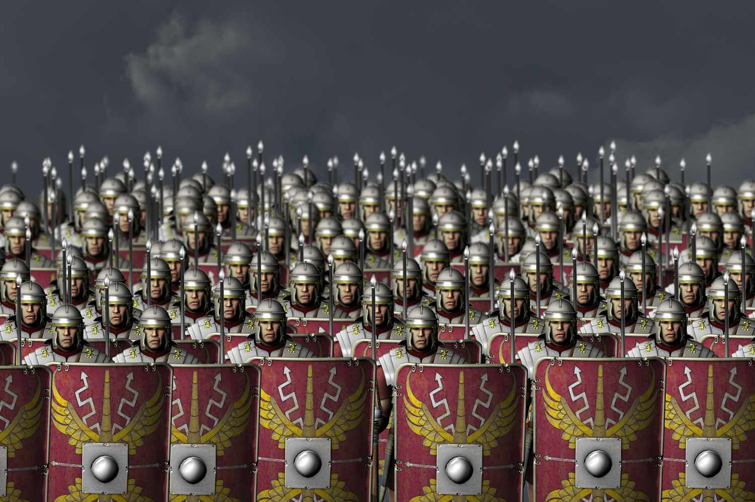
I Am Warrior Knowledge Organiser
Key Vocabulary
Boudica | Leader of the Iceni tribe (a Celtic tribe) who revolted against the Romans.
Celts | A group of tribes that lived in Britain before the Romans invaded.
Conquer | To take control of people or a place by force.
Emperor | A male ruler of an Empire, such as the Roman Empire.
Formations | The positions that the Romans stood in to fight. They include square, circle, tortoise and wedge.
Invasion | Movement of an army into a place, usually in an attack which is part of a war.
Javelins | A spear used by Roman legionaries to attack their enemies.
Legionary | A Roman soldier in a Roman army.
Revolt | To take violent action against a ruler.
Rome | The capital of Italy, where Ancient Rome began.
Key Information
1 | The Romans originally lived in Rome, the capital of Italy.
2 | The overall ruler of the Romans were Emperors. Smaller parts of the Roman Empire were ruled over by Kings.
3 | Some of the most well-known Roman emperors include Augustus, Constantine, Hadrian and Nero.
4 | The Celts lived in Britain before the Romans invaded in 43AD, looking for gold, tin, iron and cattle.
5 | Boudica was a Celtic queen who led a revolt against the Roman invasion. She was, eventually, unsuccessful.
6 | The Roman army was very well-equipped with weapons and armour. They were well trained legionaries and used formations to fight in.
7 | The Celts’ weapons, armour and battle tactics were much less effective and impressive compared to the Romans.
8 | The Romans brought many inventions to Britain including brick building, sewage systems, central heating and straight roads.
9 | The Romans started to bring Christianity to Britain although some people were still pagans.
10 | We can still see the impact of the Roman Empire on Britain today in some of our modern-day lives.
Prior Knowledge
1 | Y2 Land Ahoy! | Pirates were a type of invader who invaded and raided ships.
2 | Y2 Under Siege | Armies attacked and laid siege to castles.
3 | Y3 Gods and Mortals | The Ancient Greeks were ruled by men. Women had a much smaller role in society..
4 | Y3 Peasant, Princes and Pestilence | The peasants in the Middle Ages revolted against King Richard II.
5 | Y3 Tribal Tales | Tools and weapons were first developed during the Stone Age.

