Slide 1
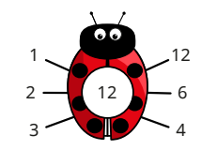
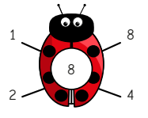
Multiplication and Division: Factors
Key Vocabulary
Factor | A number that can be multiplied by another number to give a product.
Factor pair | Two numbers that are multiplied together to give a product.
Multiple | A number that can be divided by another number, leaving no remainders.
Product | The answer to a multiplication.
Key Information
1 | To find all factors of a given number, work systematically, starting at 1.
2 | Once you begin to repeat yourself, you have found all of the factors.
Worked Examples
Working systematically to find all factors of 24: 1 x 24 2 x 12 3 x 8 4 x 6 5 x ___ → This does not work so 5 is not a factor of 24. 6 x 4 → I have already done this, so I’ll stop here.
Using factor pairs to work out 7 x 8: “I can use a factor pair of 8 to help me.” 7 x 8 = 7 x 4 x 2 7 x 4 = 28 28 x 2 = 56 Therefore, 7 x 8 = 56
Worked Examples
The factors of 12:
Prior Knowledge
Year 3 | Number: Multiplication and Division | 2, 5, 10, 3, 4 and 8 times tables.
Year 4 | Number: Multiplication and Division | 3, 6, 9, 7, 11 and 12 times tables.

