Slide 1

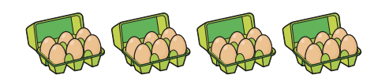
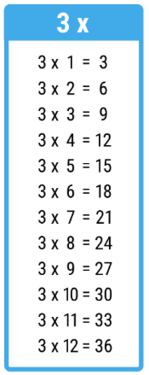
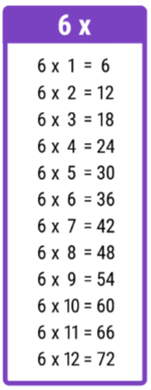
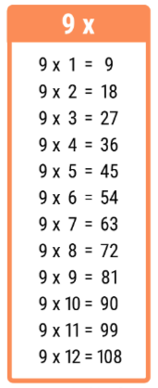
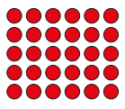
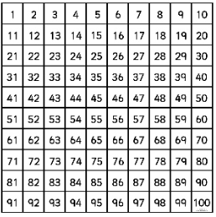
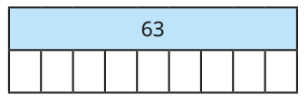
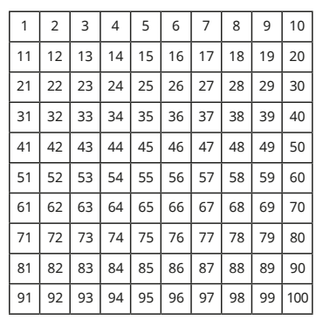
Multiplication and Division: The 3, 6 and 9 Times Tables
Key Vocabulary
Array | 9 x 4 = 36 6 x 5 =30
Hundred square
Multiple | A number that can be divided by another number, leaving no remainders.
Times table | A list of multiples of a number.
Key Information
3 times tables | 6 times tables | 9 times tables
Worked Examples
There are 4 boxes. Each box contains 6 eggs. There are 24 eggs in total. 4 x 6 = 24
9 x 7 = 63 63 ÷ 7 = 9 7 x 9 = 63 63 ÷ 9 = 7
Circle multiples of 3 in red. Circle multiples of 6 in green. Circle multiples of 9 in blue.
7
7
7
7
7
7
7
7
7
Prior Knowledge
Year 3 | Number: Multiplication and Division | The three times tables.
Worked Examples
Fact Families: 3 x 8 = 24 24 ÷ 8 = 3 8 x 3 = 24 24 ÷ 3 = 8

Slide 2
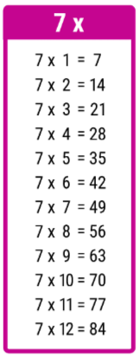
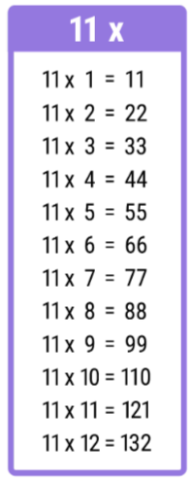
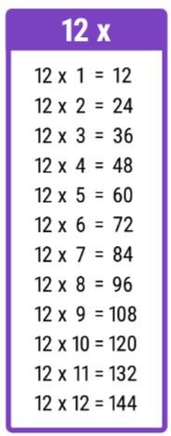
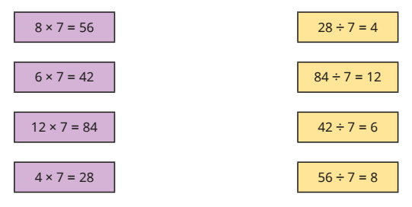

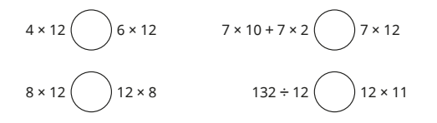
Multiplication and Division: The 7, 11 and 12 Times Tables.
Key Vocabulary
Array | 9 x 4 = 36 6 x 5 =30
Hundred square
Multiple | A number that can be divided by another number, leaving no remainders.
Times table | A list of multiples of a number.
Key Information
7 times tables | 11 times tables | 12 times tables
Worked Examples
Match the calculations to their inverse operations:
Write > < or = to make these statements correct:
11 x 3 = 33
Prior Knowledge
This is new learning.
Worked Examples
Fact Families: 7 x 11 = 77 77 ÷ 11 =7 11 x 7 = 77 77 ÷ 7 = 11
<
=
=
<

Slide 3


Multiplication and Division: Multiplying Three Numbers
Key Vocabulary
Array | 9 x 4 = 36 6 x 5 =30
Multiple | A number that can be divided by another number, leaving no remainders.
Times table | A list of multiples of a number.
Key Information
1 | Multiply two numbers together first. Then, multiply the answer by the last number in the calculation.
2 | It does not matter which two numbers you multiply first.
Worked Examples
4 x 2 x 5 This array shows 4 x 2. These arrays show 4 x 2 five times. 4 x 2 x 5 = 40
I will calculate 5 x 2 first. This makes 10. Now, I will calculate 10 x 6. This makes 60.
Worked Examples
In a field, there are 7 animal pens. 7 In each pen, there are 4 rabbit hutches. 7 x 4 In each rabbit hutch, there are 3 rabbits. How many rabbits are there in total? 7 x 4 x 3 “I will multiply 4 x 3 first to make 12. Then, I will multiply 12 x 7 to make 84.”
Prior Knowledge
Year 3 | Number: Multiplication and Division | 2, 5, 10, 3, 4 and 8 times tables.
Year 4 | Number: Multiplication and Division | 3, 6, 9, 7, 11 and 12 times tables.

