Slide 1
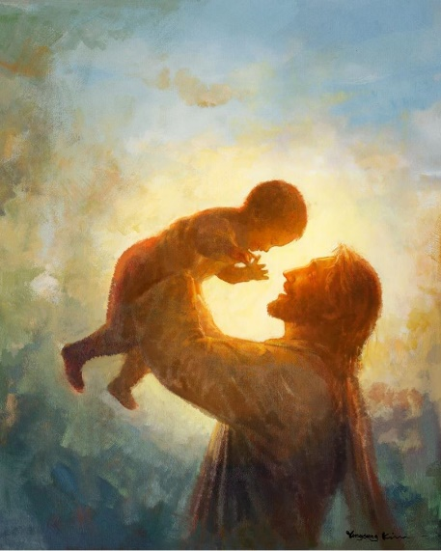
Key Vocabulary
Advent | A season in the Church year where Christians prepare for the celebration of the birth of Jesus.
Christmastide | The time from Christmas until January 5th.
Gift | Something given to someone without payment.
King Herod | The King at the time of the birth of Jesus. He was scared of Jesus’s power and Holiness.
Material and non-material gifts | Material gifts can be held and seen. Non-material gifts cannot.
Midnight Mass | A late-night Mass on Christmas Eve which often lasts until just after midnight.
Preparation | Getting ready for something.
Sacrifice | Giving something up for the good of something or someone else.
Gift Knowledge Organiser
Key Information
1 | Friendship is a gift.
2 | Material gifts and non-material gifts can be just as valued as each other.
3 | Jesus was a gift given to us by God, to show us to live and be good disciples.
4 | We prepare for, and celebrate, the gift of Jesus during Advent and at Christmas time.
5 | The Wise Men visited Jesus and brought him gifts. They were warned in a dream to avoid King Herod.
6 | Some symbols of midnight Mass include white vestments, candles and Christmas hymns.
What’s so special about gifts?
Prior Knowledge
1 | Waiting | Advent is a time of waiting. We wait in the same way that Mary waited for Jesus to be born.
2 | Preparations | Mary and Joseph had to prepare for the birth of the baby Jesus. Jesus came to us as God’s gift because He loves us.
3 | Visitors | The shepherds were some of the people that visited Jesus.
Key Scripture Links
1 | Ephesians 1:3-6
2 | Isaiah 40:9-11
3 | Matthew 2:1-12, 16-18

