Slide 1
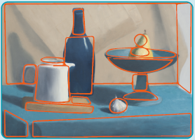
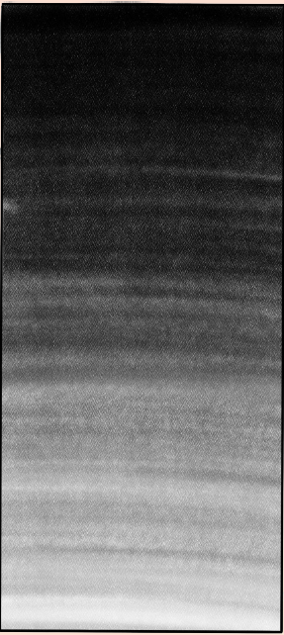
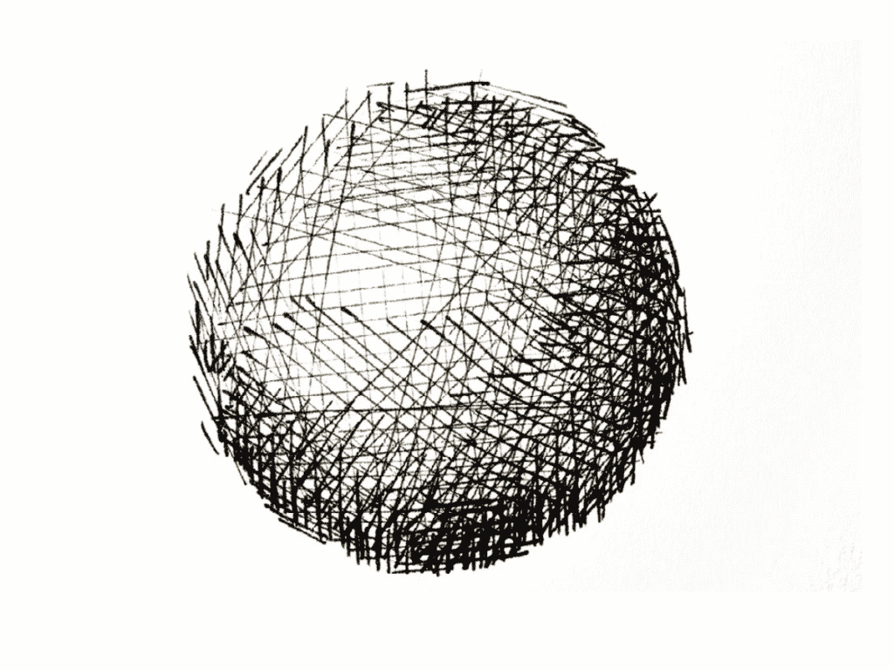
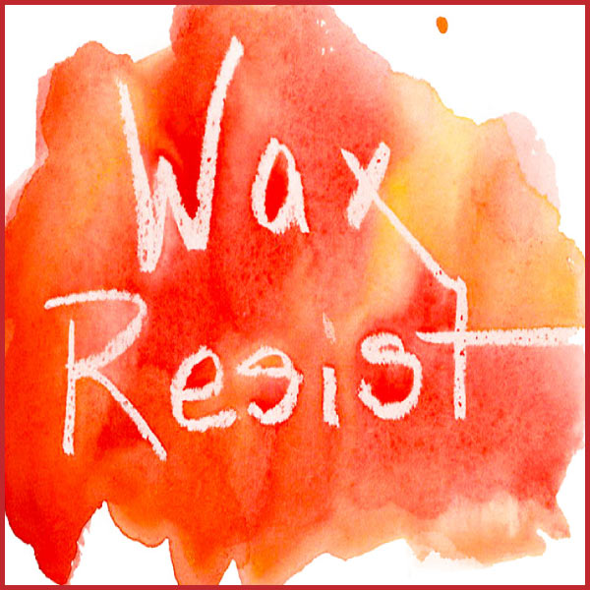
Key Vocabulary
Abstract | Art where the subject doesn’t necessarily look like it does in real life.
Block print | A print created using a carved block.
Composition | The way elements are combined or arranged.
Cross-hatch | Lots of lines that cross over each other to create light and dark areas.
Gradient | A gradual change between colours.
Mixed media | Art created using more than one type of material.
Proportion | The size of elements in art, compared to each other.
Shading | The darkening of an artwork.
Three-dimensional (3D) | Art which shows height, width and depth.
Tone | Lightness and darkness in art.
Wax resist | Using wax to create a pattern.
Art – Drawing
Knowledge Organiser
Key Knowledge
1 | Different pencil grades can create different tones.
2 | Shading can create different tones which can make drawings look 3D.
3 | We can show how big an object is in comparison to another, using proportion.
4 | Choosing where to place elements of an artwork is composition.
5 | Contrast can be achieved by combining different shapes, sizes and textures in one artwork.
6 | Tone can also be achieved through cross-hatching.
7 | Cross-hatching can be used to add contrast and to create patterns in art.
8 | Printing can be used to recreate the same pattern or artwork over and over again.
Prior Knowledge
Year 1 | Drawing | Different drawing tools can create different marks.
Year 1 | Drawing | Drawing tools could include pencils, pens, charcoal, pastels and felt tips.
Year 3 | Painting and Mixed Media | Different drawing tools can create different types of line.
Year 3 | Painting and Mixed Media | Light and dark colours next to each other create contrast.
Year 3 | Painting and Mixed Media | Shading can add texture to an artwork.
Key Artists
Henri Matisse – A French printmaker. Georges Seurat – Used pointillism to create shade and tone.

