Slide 1
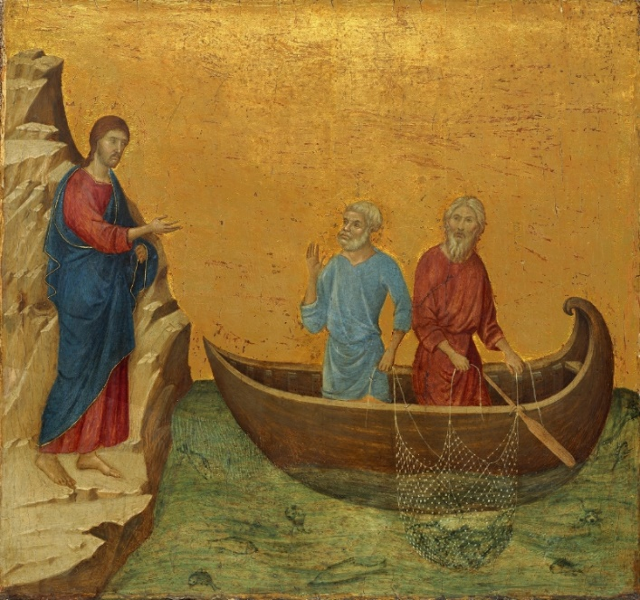
Key Vocabulary
Apostles | Each of the twelve disciples (special friends) of Jesus.
Calling | A strong urge for a particular way of life or vocation.
Confirmation | A Sacrament where a person renews their Baptismal promises.
Crozier | A hooked stick carried by a Bishop, showing his power.
Martyr | A person who dies for what they believe in.
Missionary | A person sent on a religious mission to spread Christianity.
Mitre | A headdress worn by a Bishop to show his power.
Oil of chrism | A special oil used for anointing which symbolises the gifts of the Holy Spirit.
Prophet | A messenger of God.
Saint | A Holy person in Heaven who has achieved great things.
Sean Devereux | A man who died for his beliefs.
Vocation | A job which requires care and dedication.
Called Knowledge Organiser
Key Information
1 | God calls us to do special jobs and to act in certain ways. These are our callings.
2 | Samuel was called by God and he listened to God’s message.
3 | Jesus had twelve special friends, his apostles, who He asked to help Him spread the Good News of God.
4 | Sean Devereux was a missionary. He worked for the poor and needy. He was killed for his beliefs.
5 | Confirmation is a special Sacrament where a person renews their Baptismal promises and embeds their place in God’s family.
What does it mean to be called and chosen?
Prior Knowledge
1 | Belonging | Baptism is an invitation to belong to God’s family.
2 | Signs and Symbols | Some signs and symbols of Baptism include Holy water, oil of chrism and a white garment.
3 | Promises | Parents and godparents make special promises on behalf of their children and godchildren. These promises include being a good Christian.
Key Scripture Links
1 | Samuel 2:11, 3:3-10, 3:19-21
2 | Mark 1:14-20

