Slide 1
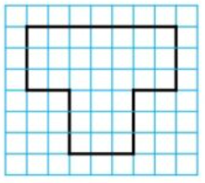
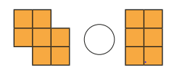
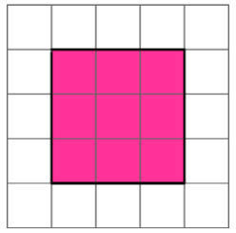
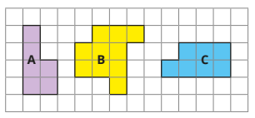
Measurement: Area
Key Vocabulary
Area | The amount of space that a 2D shape takes up.
cm2 | The unit of measurement used to measure area.
Rectilinear | A 2D shape which has straight sides and right angles.
Two-dimensional (2D) | A flat shape that you can measure the length and width of.
Key Information
1 | Some rectilinear shapes look like two rectangles together. These shapes can be chunked into rectangles to help work out the area.
2 | Area can be calculated by counting the amount of squares inside the shape.
3 | Area can be calculated by multiplying the length of one side by another side.
Worked Examples
Each square is 1cm.
Use > < or = to compare the area of these shapes:
Order these shapes from greatest to smallest area: B, C, A
There are 30
squares inside
this rectilinear
shape.
The area = 30cm2.
>
Worked Examples
Each square is 1cm. There are 9 squares inside this square. The area = 9cm2
Prior Knowledge
Year 3 | Measurement: Length and perimeter | Perimeter is the length of all sides of a shape, added together.

