Slide 1
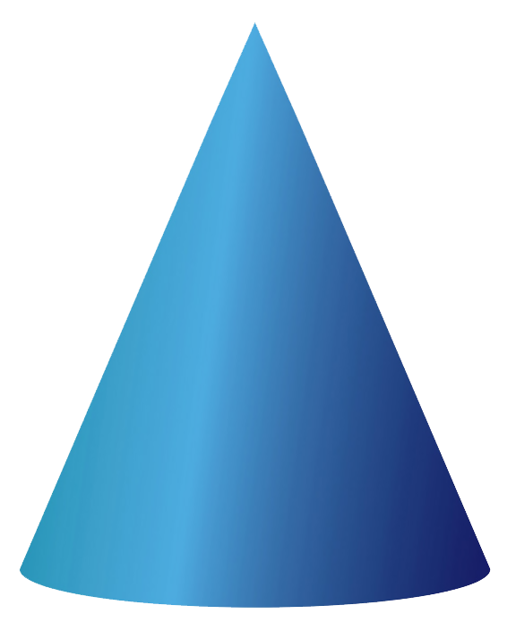
Building 9&10 – 3D Shapes – Printing With 3D Shapes
R
Look at the print in the playdough.
Circle the 3D shapes that could have made the print.

Slide 2
Building 9&10 – 3D Shapes – Printing With 3D Shapes
R
True or False?
A cone made this print in the playdough.
Explained to an adult?
Building 9&10 – 3D Shapes – Printing With 3D Shapes
R
True or False?
A cone made this print in the playdough.
Explained to an adult?

Slide 3
Building 9&10 – 3D Shapes – Printing With 3D Shapes
Answers
R
True or False?
A cone made this print in the playdough.
Children should explain that this is false. A cone has a circle face so it could not have made this print in the playdough.
Building 9&10 – 3D Shapes – Printing With 3D Shapes
Answers
R
True or False?
A cone made this print in the playdough.
Children should explain that this is false. A cone has a circle face so it could not have made this print in the playdough.

