Slide 1

St Joseph’s Catholic Primary and Nursery School
Relationship, Sex and Health
Education (RSHE)
A Presentation for Parents

Slide 2
RSHE within schools
“The Department for Education is introducing compulsory Relationships Education for primary pupils and Relationships and Sex Education (RSE) for secondary pupils from September 2020. Also from September 2020, it will be compulsory for all schools to teach Health Education….
…..we believe the contents of these subjects – such as family, friendship, safety (including online safety) – are important for all children to be taught.”
(DFE)
RSHE, as it is known in our school, is the teaching of Relationships, Sex and Health Education at an age appropriate level for the pupils in our school. It is the life long learning about physical, moral and emotional development.
It is the understanding of the importance of family life, stable and loving relationships, respect, love and care.

Slide 3
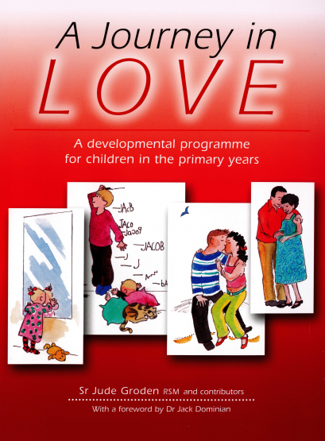
A Journey in Love
A journey in love has as its foundational premise the belief that we are made in the image and likeness of God and, as a consequence, gender and sexuality are God’s gift, reflect God’s beauty and share in the divine creativity.
It is not intended to be purely sex education.
It is intended to provide the growing child with an understanding of life itself appropriate to their level of understanding.
It reinforces Christian values and opens doors for discussion.

Slide 4
A Journey in Love
The central message of the Christian faith is love. The central message of our RSHE teaching is love.
“My commandment is this: love one another, just as I have loved you”
John 15:12

Slide 5
Journey in Love
Nursery – Wonder at God’s Love
Owls – God loves each of us in our uniqueness
Year One- We meet God’s love in our family
Year Two- We meet God’s love in our community
Year Three- How we live in love
Year Four- God loves us in our differences
Year Five- God loves me in my changing and development
Year Six- The wonder of God’s love in creating new life

Slide 6
RSHE throughout the Year
Each year group has a different focus. Across the year, each term, the children will look at a different aspect of this.
Advent 1 – My relationship with God
Advent 2- Physical
Lent 1 - Social
Lent 2 – Emotional
Pentecost 1- Intellectual
Pentecost 2 - Spiritual

Slide 7
Within each theme…
Discussion
Prayer
Reflection
Activities

Slide 8
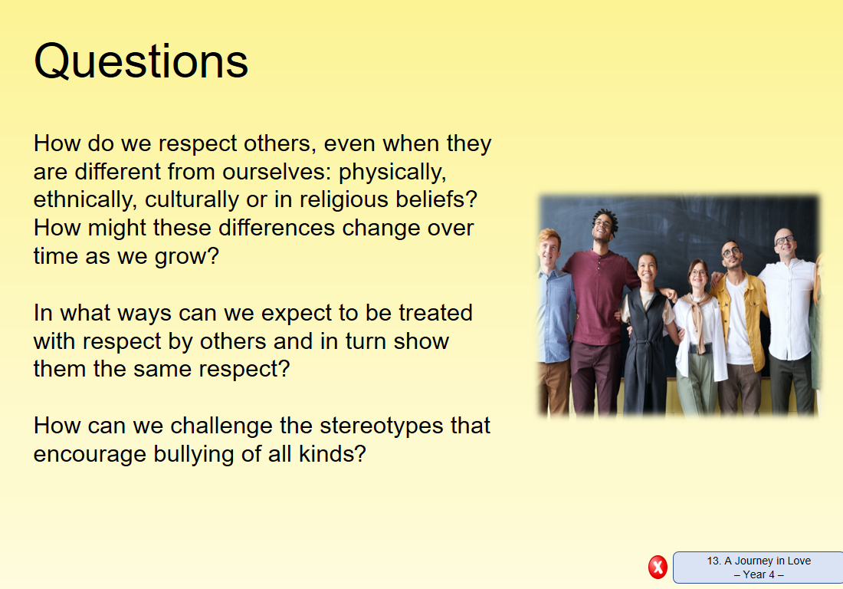
Discussion
Notes:
Example Discussion questions

Slide 9
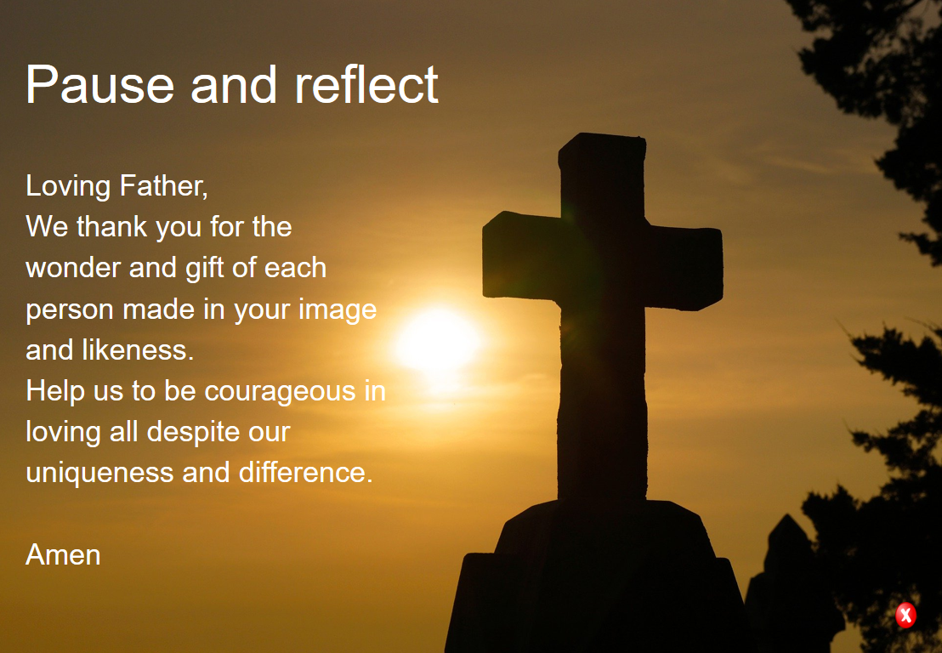
Prayer and Reflect
Notes:
Example prayer and reflection

Slide 10
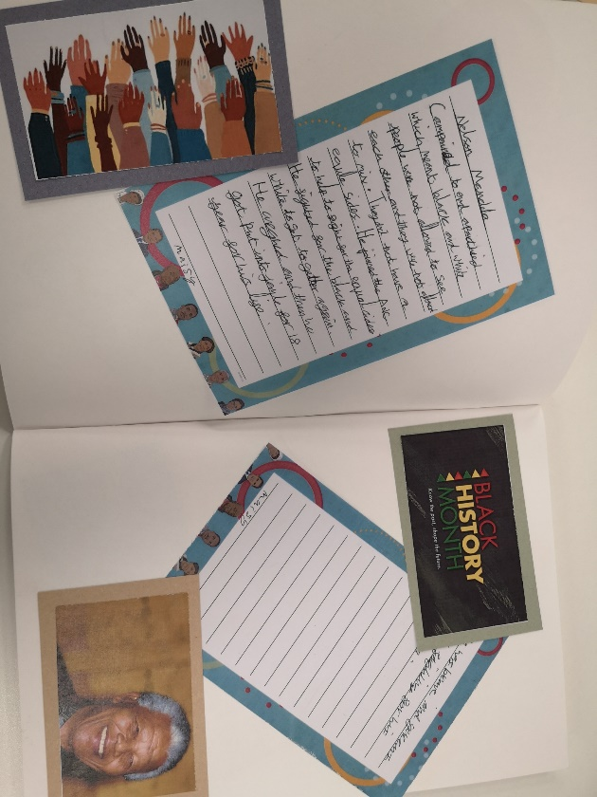
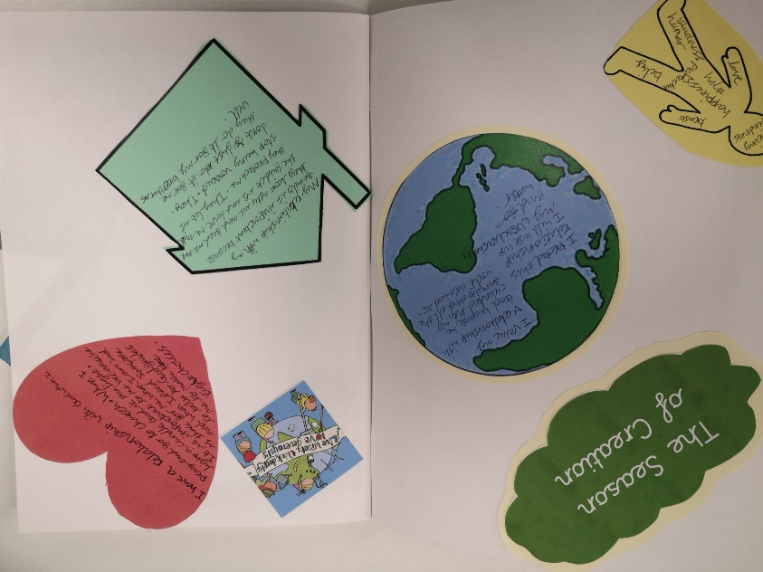
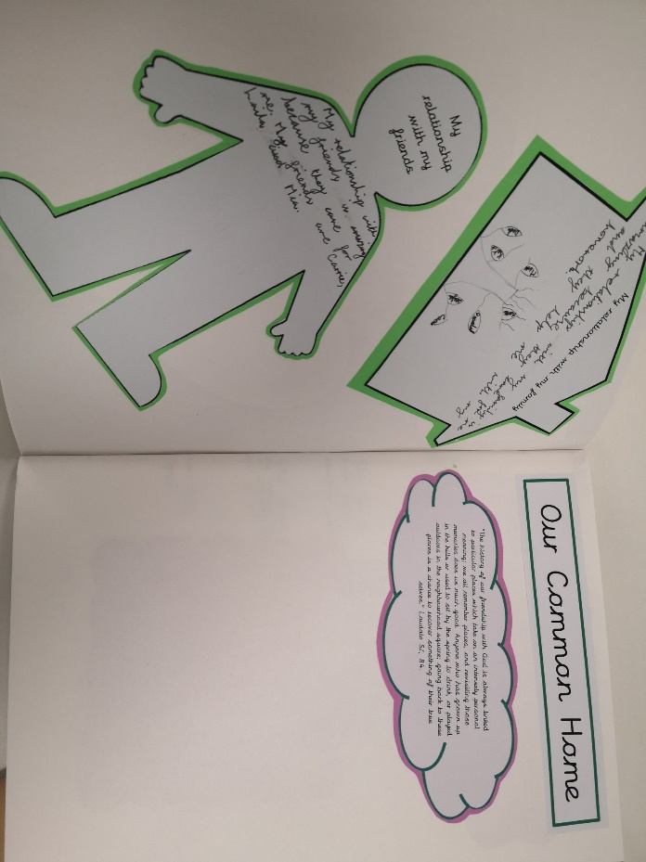
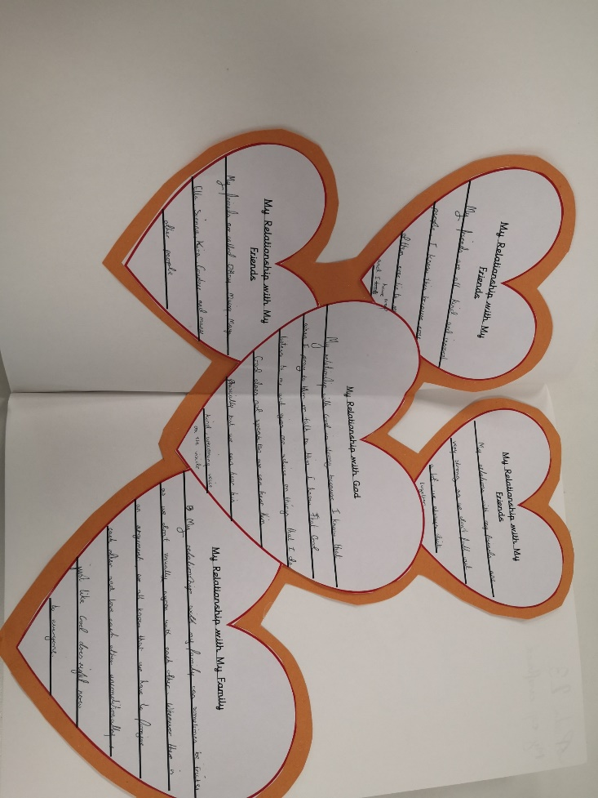
Activities

Slide 11
Early Years
Children begin to explore the wonder of being special and unique.
Examples of Early Years questions:
Why are you special to your family?
How do you know that you are special?
What do you love and enjoy about belonging to your family?
Who would you go to if you felt worried or needed help?
How does God show love to you and your family?

Slide 12
Year One
Children focus on families and specially growing up in a loving, secure and stable home.
Examples of Year 1 questions:
How is love shown in your family?
Why are the words ‘please’, ‘thank you’ and ‘sorry’ important to create a happy family?
Why is teasing and bullying wrong and unacceptable within families and friendships?
Why should we always tell the truth?

Slide 13
Year Two
Children describe how we are growing and developing in diverse communities that are God-given.
Examples of Year 2 questions:
How would you describe a community?
What are the joys of belonging to a community?
How do different individuals enrich a community?
What do you bring to the community that you belong to?

Slide 14
Year Three
Children describe and give reasons for how we grow in love and caring and happy friendships where we are secure and safe.
Examples of Year 3 questions:
How do friendships make us feel happy and secure?
How can friendships change?
Why is violence never the answer?
What Bible stories teach us about the beauty of forgiveness?

Slide 15
Year Four
Children make links and connections to show that we are all different. They learn to celebrate these differences as we appreciate that God’s love accepts us as we are now and as we change.
Examples of Year 4 questions:
In what ways is being polite and courteous helping to make a better world to live in?
How do authority figures help communities and societies work together better?
How do we respect others even when they are different from ourselves?
How can your gifts be used for the common good?

Slide 16
Year Five
Children know and become aware of the physical and emotional changes that accompany puberty- sensitivity, mood swings, anger, boredom, etc.
They grow further in their understanding of God’s presence in their daily lives.
Examples of Year 5 activities:
Identify and celebrate the ways I have changed since birth
Discuss the external and internal changes which happen to boys and girls in puberty- pupils may be divided into male and females and taught separately for this section of the unit
Recognise behaviour changes as we grow up
Identify that physical changes from child to adult means the ability to become a mother or father
Reflect on ways to become more sensitive to the emotional development of oneself and of others

Slide 17
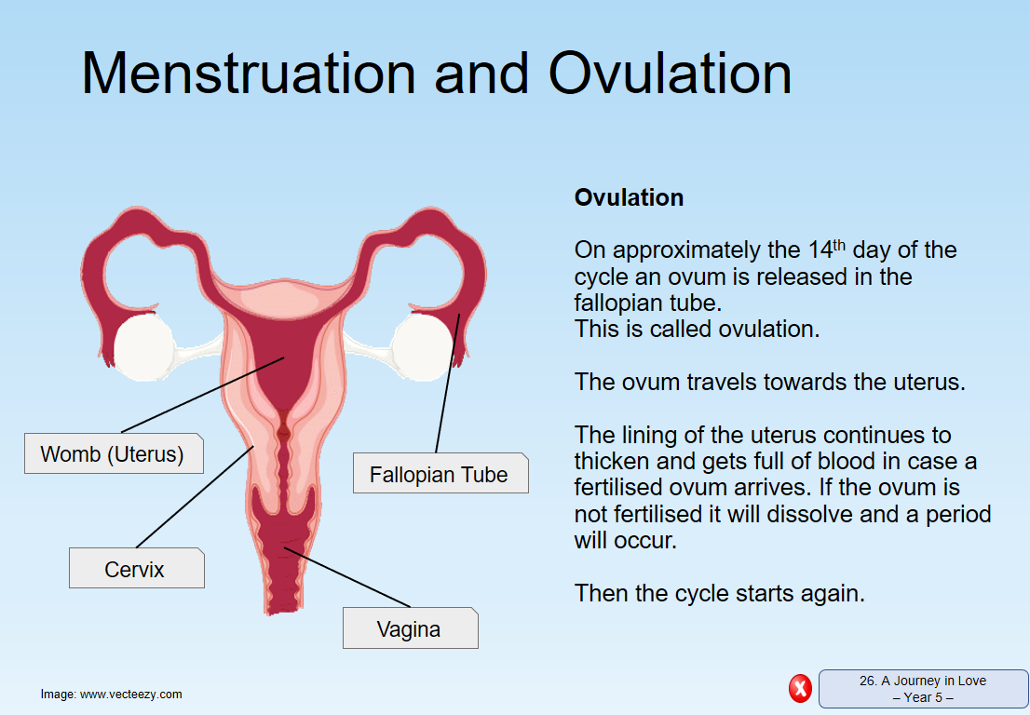
Year Five Example Content

Slide 18
Year Six
Children develop a secure understanding of what stable, caring relationships are and the different kinds there may be. Focusing on Catholic teaching, children will also know and understand about the conception of a child within marriage.
Examples of Year 6 activities:
Explain how human life is conceived
Recognise Male and female reproductive organs- children may be separated into males and females for this section
Know that sexual intercourse occurs between husband and wife
Understand how a child grows within the mother’s womb
Understand that God causes new life to begin through the love that parents have for each other

Slide 19
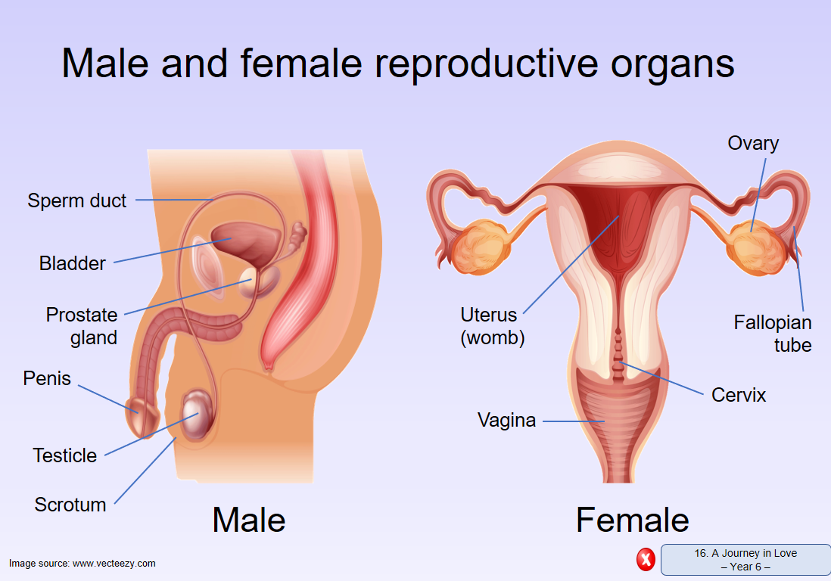
Year Six Example Content

Slide 20
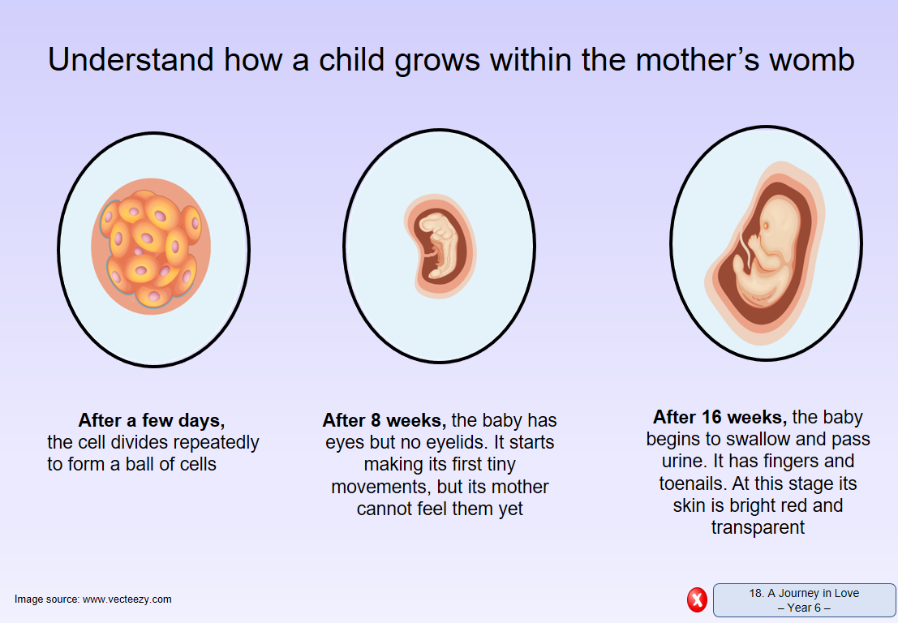
Year Six Example Content

Slide 21
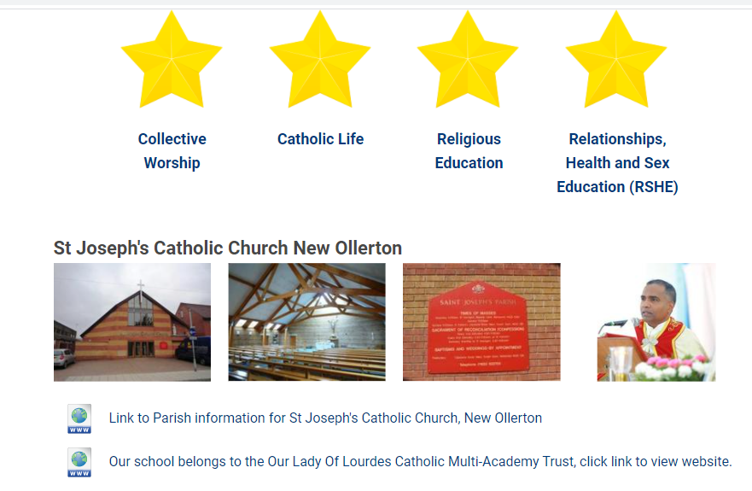
Questions
Any further questions please add them to the chat box below or email them to homelearning@st-joseph-pri.nott.sch.uk

