Slide 1
Emotional Literacy Support Assistant (ELSA) Programme.

Slide 2
As a response to the COVID crisis, all the schools within the Our Lady Of Lourdes Multi-Academy Trust have been invited to take part in the ELSA training to support the impact of school closures and Covid on our most vulnerable children.
As stated by the DFE: ‘School closures put educational outcomes at risk, especially for disadvantaged students. Existing inequalities and attainment gaps are already being exacerbated. School closures cause impairment to the physical and mental health of children. Evidence suggests that the mental health of Years 4, 5 and 6 and early secondary school is particularly affected. Cognitive, social, and emotional developmental outcomes are also at risk as is physical health. School closures have a particularly adverse impact on vulnerable children due to reduced access to essential services. Other lockdown-related stress for children and parents, such as economic uncertainty, are also likely to be exacerbated.’
The ELSA programme is designed to provide intensive support to these vulnerable children and to provide a long term social, emotional and mental health intervention in our primary schools.
Notes:
With our COVID recovery funding, we prioritised the social, emotional and mental health recovery for our pupils. I set about organising ELSA training for several schools within the Trust to provide this emotional support.

Slide 3
What is Emotional Literacy?
Claude Steiner (1997) psychotherapist ‘To be emotionally literate is to be able to handle emotions in a way that improves your personal power and improves the quality of life around you.’
‘Emotional literacy improves relationships, creates loving possibilities between people, makes co-operative work possible, and facilitates the feeling of community.’
5 Key Elements:
Knowing your feelings
2. Having a sense of empathy
3. Learning to manage our emotions
4. Repairing emotional problems
5. Putting it all together: emotional interactivity
Notes:
The ELSA programme is organised by educational phycologists and in principle- provides your school with in house councillor's to deal with day to day trauma or anxiety in children. When you look at the number of vulnerable children our school have hosted during this recent lockdown, it is clear why this resource is necessary. As stated above ‘emotional literacy improves the quality of life around you’ and that is vital for our children.

Slide 4
Resilience:
What does being resilient mean?
“You can't stop the waves, but you can learn to surf" (Kabat-Zinn 2004)
Resilience is the process of adapting in the face of adversity, trauma, tragedy, threats or significant sources of stress. It means bouncing back from difficult experiences. Being resilient does not mean that a person doesn’t experience difficulty or distress. (APA.org)
Notes:
Resilience is a large focus for the programme, as it teaches the children how to be adaptable and resilient in our ever changing world- a much needed life skill for some of our more vulnerable pupils.

Slide 5
Positive Mental Health
What do we mean by positive mental health?
Mental health includes our emotional, psychological, and social well-being. It affects how we think, feel, and act.
It also helps determine how we handle stress, relate to others, and make choices (Mentalhealth.gov)
Mental health problems may well arise when: “…the demands placed on any individual exceed their resources and coping abilities” (World Health Organisation)
Notes:
Another focus which we have linked to the new PHSE curriculum is on mental health awareness. ELSA provides children with an emotional toolkit for when they may find themselves struggling. This will hopefully impact on behaviour outbursts and refusal to engage in learning for some pupils.

Slide 6
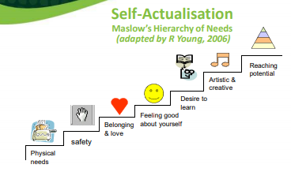
Why is Emotional Literacy Important?
If you cannot manage your emotions, it is harder to be content, sociable and learn.
If we are able to manage our emotions, we are not overwhelmed by them and this links with positive mental health.
All feelings are ok, it’s what we do with them that matters.

Slide 7
The ELSA Programme:
Active Listening Skills and Reflective Questions
Using Circle Time
Self Esteem and Resilience
Belonging and Friendship Skills
Understanding and Regulating Strong Emotions
Therapeutic Stories
Social Communication and Supportive Intervention
Loss and Bereavement

Slide 8
The benefits of focusing on Emotional Literacy
feel good – learn better
Raises standards
Makes learning more enjoyable
Reduces unnecessary stress
Turns vicious circles into virtuous circles
(Sharp, 2001)

Slide 9
ELSA at St Joseph’s
2 x trained ELSA within the Teaching Assistants staff (Shelley Bracegirdle and Tracey Whitton)
4 x afternoon blocks per ELSA staff to run small group, individual ELSA sessions and a weekly whole class ELSA session (meaning all the pupils across the year will benefit from the support).
Creation of an ELSA space within the Rainbow Room with adequate resources.
Children will be assessed at the start of ELSA programme and every 6 weeks there after (for some children dependent on assessment, 6 weeks is sufficient intervention time, for others the ELSA programme may run for several terms).
An ELSA report will be presented to Governors annually as part of the SEN review.

Slide 10
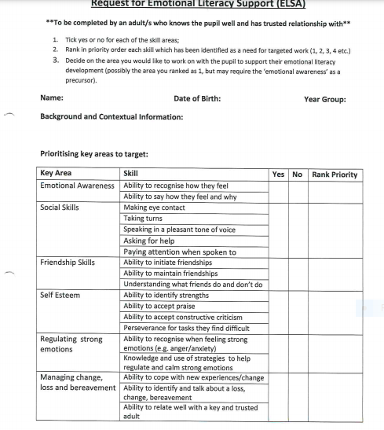
Notes:
This is an example of the staff referral form when wanting to send a pupil to the ELSA programme. An assessment is then carried out prior to commencing programme to ascertain difficulties the child may have.

